Slide 1



Macrosystems EDDIE: Using Data to Improve Ecological Forecasts
Lofton, M.E., Moore, T. N., Thomas, R. Q., Carey, C.C. 07 March 2024.
Macrosystems EDDIE: Using Data to Improve Ecological Forecasts.
Macrosystems EDDIE Module 7, Version 1.
https://serc.carleton.edu/eddie/macrosystems/module7
Module development supported by NSF DEB-1926050; NSF DBI-1933016
Notes:
Welcome the students to class.
It is important at this point to emphasize that there will be lots of new material covered during this module, and that going slowly and asking for help is very much encouraged!

Slide 2
Overview of today
Introduce the concepts of ecological forecasting, forecast accuracy and uncertainty, and data assimilation
Activity A: Access and explore data from an ecological site of your choice in the National Ecological Observatory Network, then fit a model and generate a forecast of lake chlorophyll-a
Activity B: Explore how updating model predictions with data affects forecast accuracy, including the effects of data observation uncertainty and temporal frequency
Activity C: Explore the effect of assimilating sensor data at different frequencies on management decision-making.
Notes:
Quick road map of what will be covered in this lesson
Overview slide for the day (will require instructor edits if adapting for different class lengths!)
Three classes (50-60 minutes)
Class 1 – Introductory lecture (30 min.) and completion of Activity A, Objectives 1 and 2 (20 min.)
Class 2 – Completion of Activity A, Objectives 3 and 4 (30 min.), and Activity B, Objectives 5 and 6 (20 min.)
Class 3 – Completion of Activity B, Objective 7 (15 min.), and Activity C (15 min.); wrap-up (20 min.)
Two classes (75-90 minutes)
Class 1 – Introductory lecture and completion of Activity A
Class 2 – Activity B & C followed by 10-15 minute presentation discussion of each groups' results
One class (3 hours)
Introductory lecture – 30 mins, Activity A – 45 mins, break – 5mins, Activity B – 45 mins, group presentation/discussion – 15/20mins, Activity C – 20 mins

Slide 3

Ecosystems are changing worldwide…
In response to changes in climate and land use, ecological functioning in many aquatic and terrestrial systems is changing
Lakes and reservoirs provide many ecological services; thus, understanding how these ecosystems will change in the short-term will help us better manage these vital resources
Ecological forecasting is a potentially powerful tool to help lake and reservoir managers preemptively prevent or mitigate water quality concerns
Image: Wikimedia commons
Notes:
Big picture, we frame ecological forecasts in the context of changing climate and land use. Our focus today is on aquatic ecosystems: management of these resources could be improved by having advance knowledge of how they could potentially change in the near-term (e.g., 1 to 30 days in the future).
Why do we want to generate ecological forecasts? Answer: Because there is lots of variability in how climate change is occurring globally and lakes provide critical ecosystem services for humans, so ecological forecasts are critical to help management of these resources.

Slide 4
Before we start:
What is an Ecological Forecast?
A prediction of future environmental conditions
with uncertainty
Events have not yet occurred
Gives a probability or a likelihood of the event to occur (uncertainty)
Actionable
Notes:
Ask the class “What is a Forecast?” – if teaching virtually, prompt them to either type answers into the chat or raise their hand to ask the question. Key aspects of a forecasts are listed in the slide.
Actionable implies that the information is given in a time frame that allows for a response. For example, you could forecast air temperature five minutes into the future with relatively low uncertainty, but this is not much use compared to a forecast for air temperature three days into the future.
Highlight the inclusion of uncertainty, which is critical to give decision-makers a clear picture of the probability of different forecasted outcomes, and the focus of the module today.

Slide 5
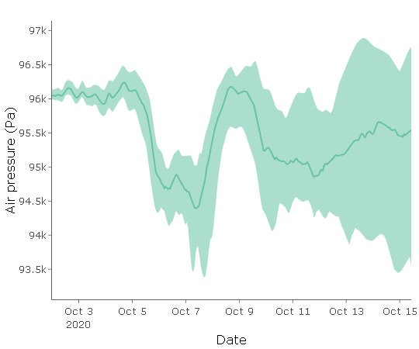
What is uncertainty?
?
?
Forecast uncertainty: the set of possible alternate future conditions predicted by a model and the chance of observing each outcome.
We generate multiple different predictions of the future because the future is inherently unknown.
Uncertainty generally increases as the forecast horizon increases.
Forecast horizon: the length of time into the future for which a forecast is generated
Quantify Uncertainty
Plot showing 16-day-ahead forecast of air pressure with shaded regions showing 95% confidence interval and the solid line represents the median
Notes:
Forecast uncertainty: the set of possible alternate future conditions predicted by a model and the chance of observing each outcome
We generate multiple different predictions of the future because the future is inherently unknown.
Uncertainty generally increases with time into the future.
Here is a plot showing 16-day forecast of air pressure with shaded regions showing 95% confidence interval and the solid line represents the median. The confidence interval represents the uncertainty in the forecast.

Slide 6




?
?
Quantify Uncertainty
Generate
Forecast
The Forecast Cycle
Build Model
Communicate Forecast
?
Create
Hypothesis
Assess Forecast
Update Model with Data
Notes:
Briefly (!!) introduce each point in the forecast cycle. Highlight that it is “iterative” which means that it is a repetitive process, hence why it is described as a cycle
Create Hypothesis – use the example of how primary productivity is affected by water temperature and underwater light.
Build Model – use data to build a mathematical model to describe the observations of water temperature. Driver data are variables (such as future water temperature and underwater light) which can be used to drive the model.
Quantify uncertainty – this is a key step. There are several different types of uncertainty sources that could be included: e.g., driver, process, parameter, initial conditions.
Generate Forecast – using the model built for generating a forecast of primary productivity.
Communicate Forecast – potential forecast users could include a water resource manager for a drinking water reservoir. There are different ways to communicate a forecast, but this is a critical step as a forecast is not effective for helping management if it is not communicated effectively to end users.
Assess forecast – As time goes on, new data are collected and then this can be compared to previous forecasts to assess how accurate the forecast was.
Update model – if the model is not accurately predicting observations, the model can be updated by changing the model parameters, adding a new driver variable; additionally, a model can be updated via data assimilation, which is using the most recent observations to update the model’s initial, or starting, conditions to ensure the most accurate possible forecast
In this module, we will be focusing on building a model, quantifying the uncertainty associated with our forecast, generating a forecast, assessing the forecast, and most importantly, updating our forecast models with new data as they become available.

Slide 7


Ecological models
A model is a simplified representation of a real phenomenon, with the goal of understanding and predicting that phenomenon
Predicting chlorophyll-a concentrations in a lake
y = mx + b
y
t
Notes:
We will use ecological models to generate our forecasts
An ecological model is a simplified representation of nature, with the goal of understanding and predicting environmental dynamics
A simple version of a model is a linear regression: “y = mx + b”; for example, we might use the amount of available phosphorus in a lake as the independent variable (x) to predict chlorophyll-a (y) in a lake.

Slide 8
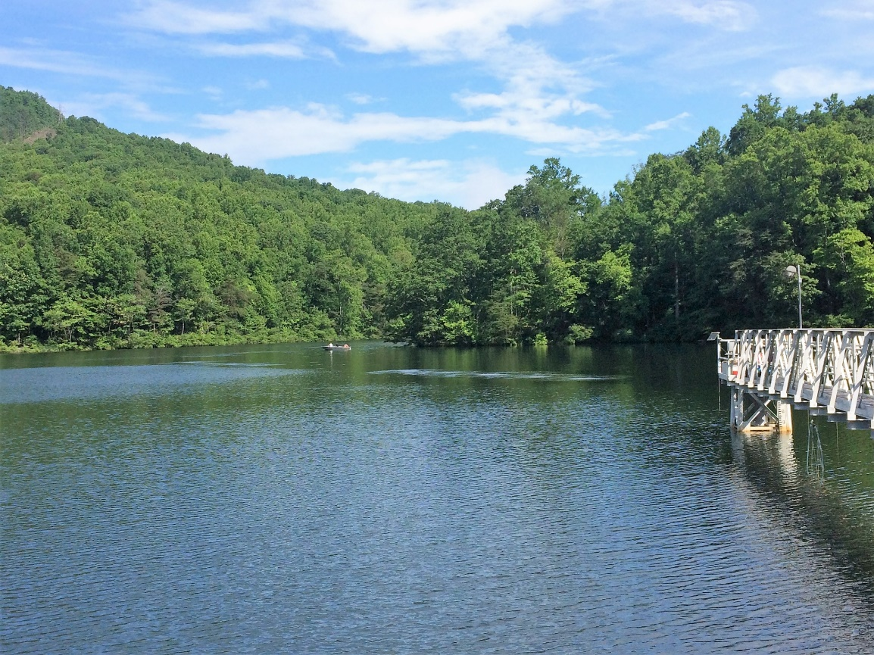
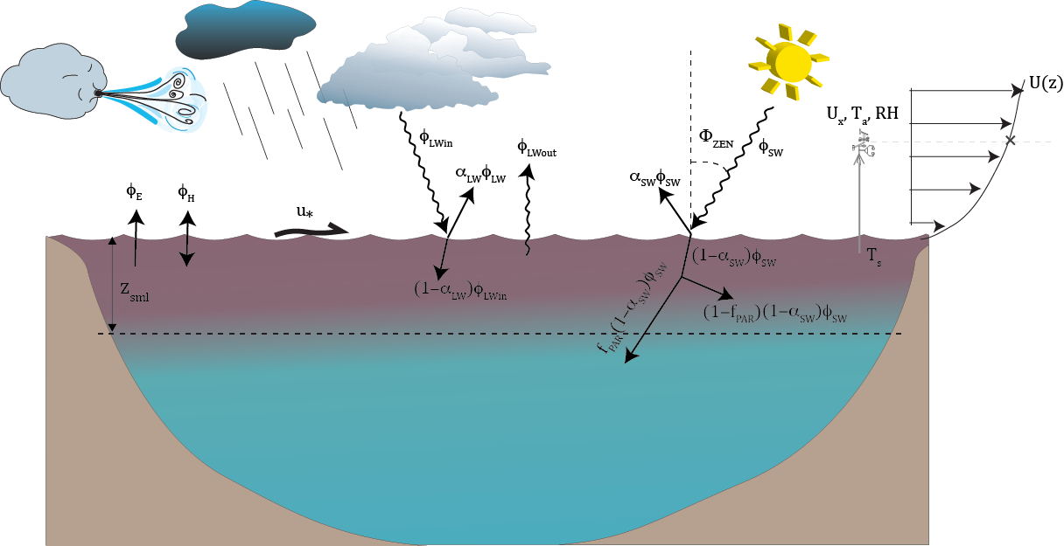
Models as imperfect representations of complex ecosystems
Models for ecological forecasting can be thought of as imperfect representations of the ecosystems they simulate
Lake
Lake Model (imperfect representation of real lake)
Model diagram courtesy of the General Lake Model (GLM) developers
https://aed.see.uwa.edu.au/research/models/glm/#
Notes:
Because they are a simplified representation of the real world, models for ecological forecasting will necessarily be imperfect representations of complex, real-world ecosystems as they represent ecosystem processes using mathematical equations, thus creating a simplified “digital lake” in your computer.

Slide 9
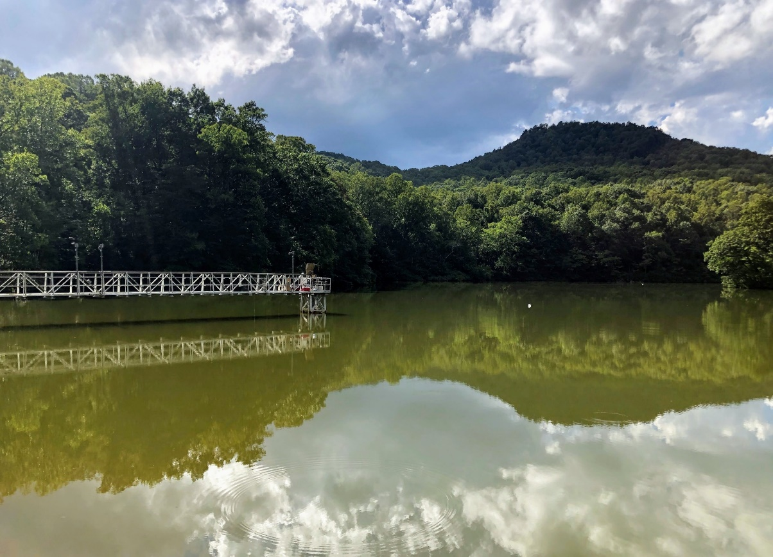
Models as imperfect representations of complex ecosystems
Models for ecological forecasting can be thought of as imperfect representations of the ecosystems they simulate
How do we make sure the model lake resembles the actual ecosystem? (e.g., the algal bloom in the lake appears in the model)
Lake
Lake Model (imperfect representation of real lake)
DATA
Model diagram courtesy of the General Lake Model (GLM) developers
https://aed.see.uwa.edu.au/research/models/glm/#
Notes:
The key question then becomes: How do we make sure the digital lake resembles the actual ecosystem as closely as possible?
For example, if this lake experiences an algal bloom event, how do we make sure the lake model is able to capture or forecast that event?
(click for animation) One way is by using data collected in the real world to calibrate and update our models so they mirror real-world conditions as closely as possible

Slide 10
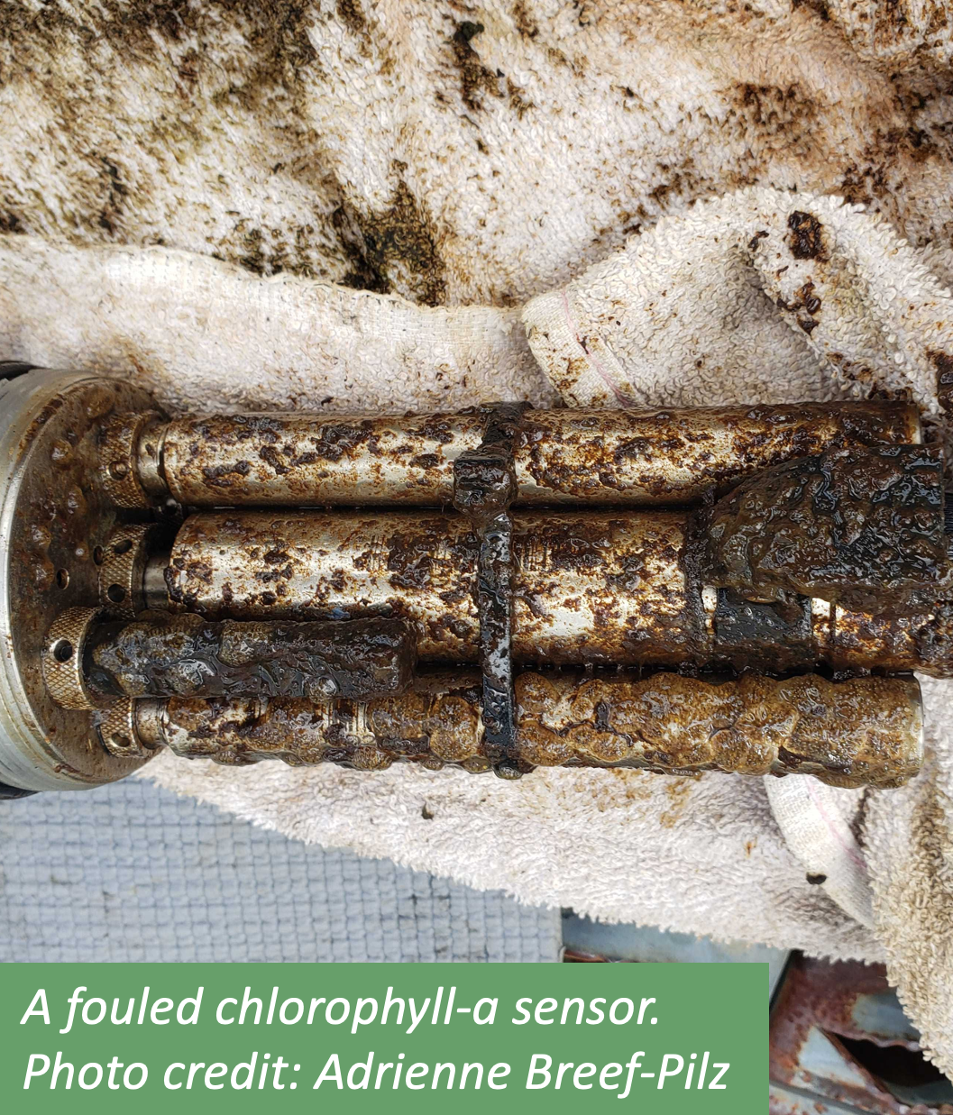
Important note: data are also imperfect!
It can be tempting to view data as “the truth”
But observational data are imperfect too:
Human error
Sensor malfunction
Limits to measurement accuracy
We must account for uncertainty in data
Ultimately, model predictions and data BOTH have value in producing accurate forecasts
Notes:
It is important to note that observational data are also imperfect
While it can be tempting to view our observational data as “the truth” (particularly when we have worked really hard to collect it!), we know that observational data are also imperfect. This can be due to:
Human error
Sensor malfunction
And limits to measurement accuracy, among other factors
When producing ecological forecasts, we must account for uncertainty in both models and data
Ultimately, mode predictions and data BOTH have value in producing accurate forecasts, as they both can provide helpful information about the ecological system that is being forecasted

Slide 11
Our focal question for today:
How can we use data to improve ecological forecasts?
Notes:
This leads to our focal question for this module: how can we use data to improve ecological forecasts?

Slide 12
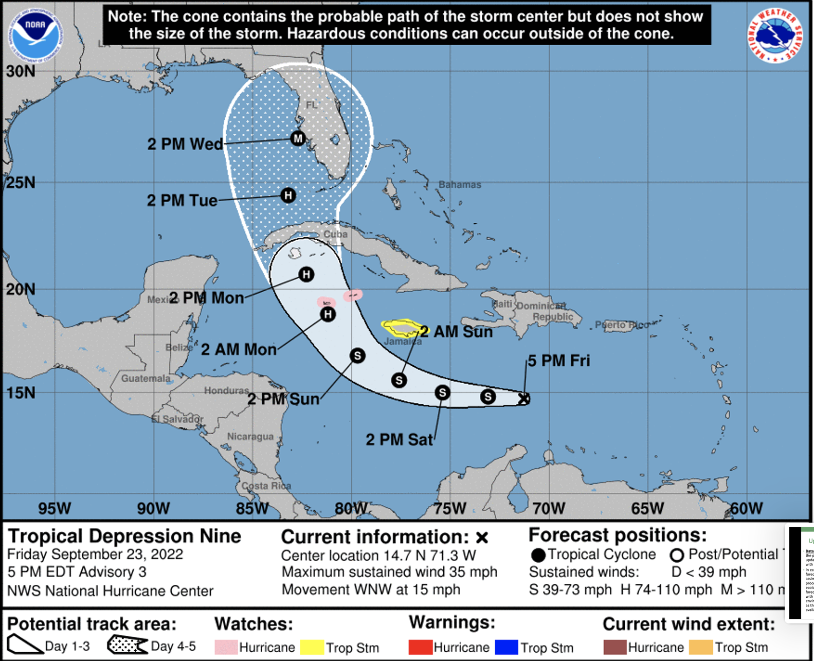
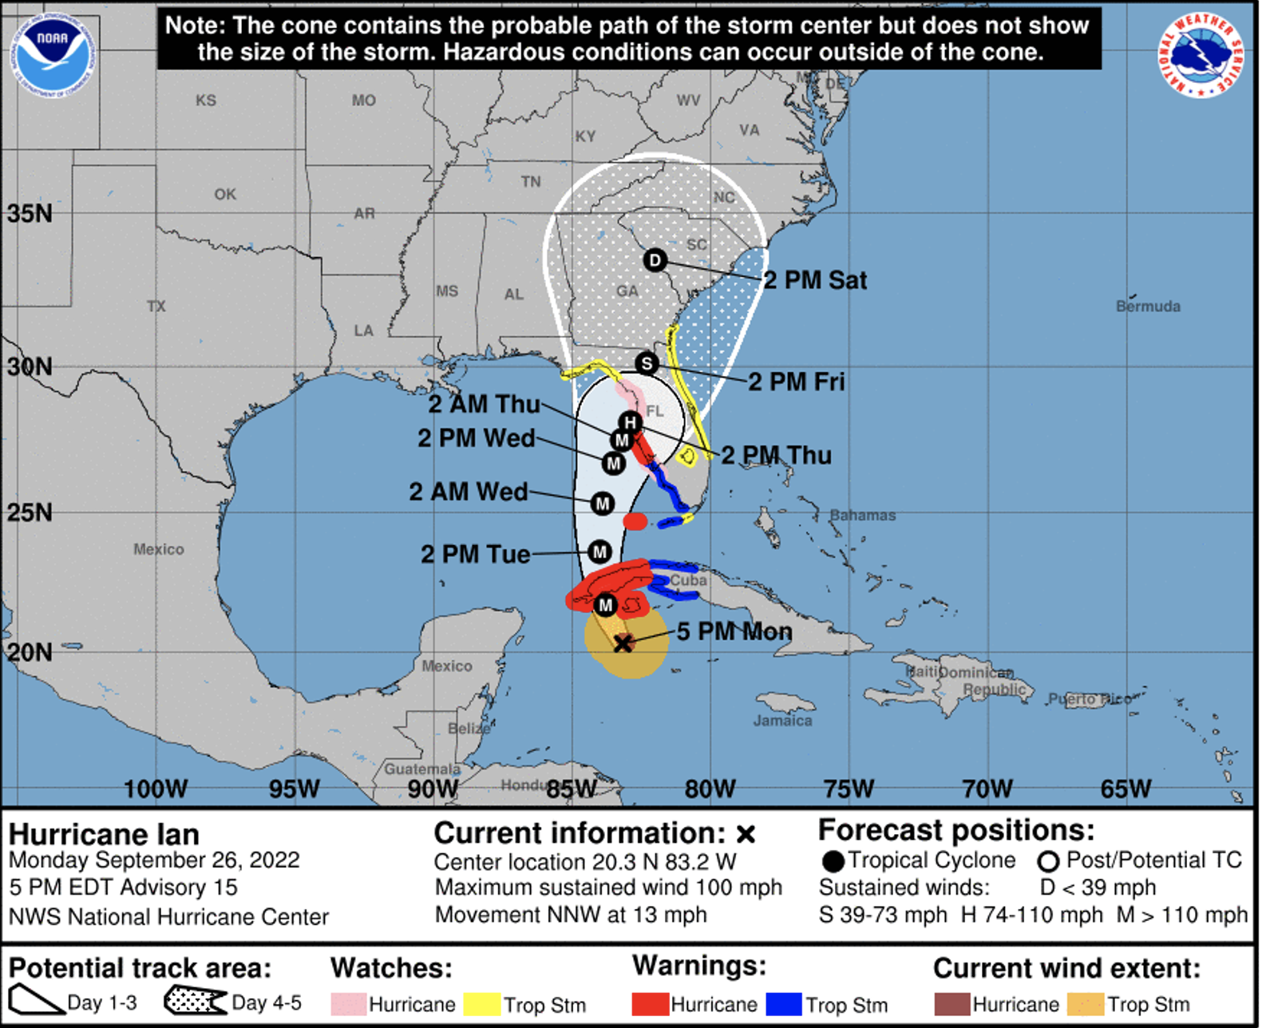
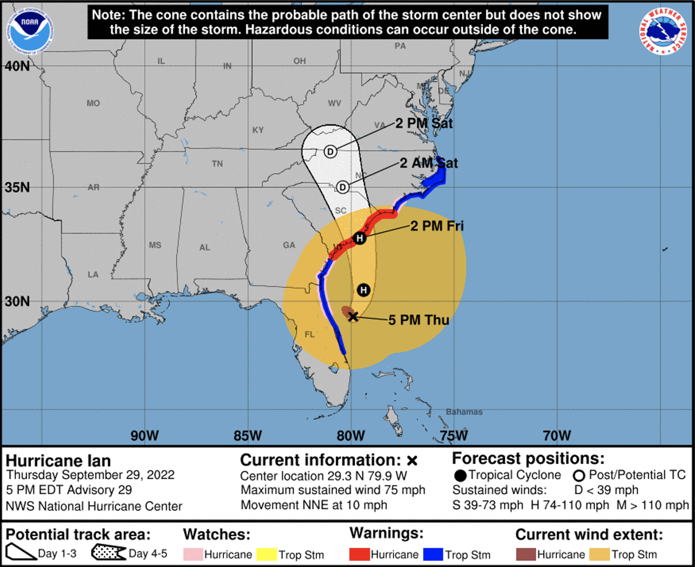
Updating forecasts with data
Data assimilation: the process of updating models with data
In ecological forecasting, data assimilation is the process of updating ecological forecasting models with new environmental data as they become available
Image credit: US NOAA
Notes:
Let’s use a familiar example to start to answer this question. We know weather forecasts are updated regularly – how is this done?
It is done through the process of data assimilation, which is the process of updating models with data. In ecological forecasting, data assimilation is the process of updating ecological forecasting models with new environmental data as they become available.
Here, you can see updated forecasts of Hurricane Ian, which occurred in 2022, as new data were used to update the forecast model over time. The Track Forecast Cone shows the most likely path of the center of a tropical cyclone. The center of a tropical cyclone historically moves out of the cone about a third of the time. The cone is formed by connecting a set of circles at each forecast time. Each circle is drawn so that it encloses 67% of the official track forecast errors over the last 5 years (hence the likelihood of the center to move out of the cone about a third of the time). Forecasts are updated over time using the most recent up-to-date position of the storm.
Image source: https://www.weather.gov/news/101722-jamie-rhome-cone.
Students may be aware that this forecast cone visualization has come under criticism for being difficult to interpret. The article associated with the image has further information on this topic if they are interested.
We’ll now walk through a high-level overview of how data assimilation is done.

Slide 13
Steps of forecasting with data assimilation
Step 1: Generate a forecast with uncertainty
Step 2: Update the forecast using data
Step 3: Generate a new forecast
Notes:
At a high level, the process of data assimilation involves three steps.
First, you generate a forecast with uncertainty.
Next, as the future arrives, you update the forecast model using new data when they become available
Finally, you use the updated forecast model to generate a new forecast that reflects your updated data.
We will now walk through each of these steps in more detail.

Slide 14
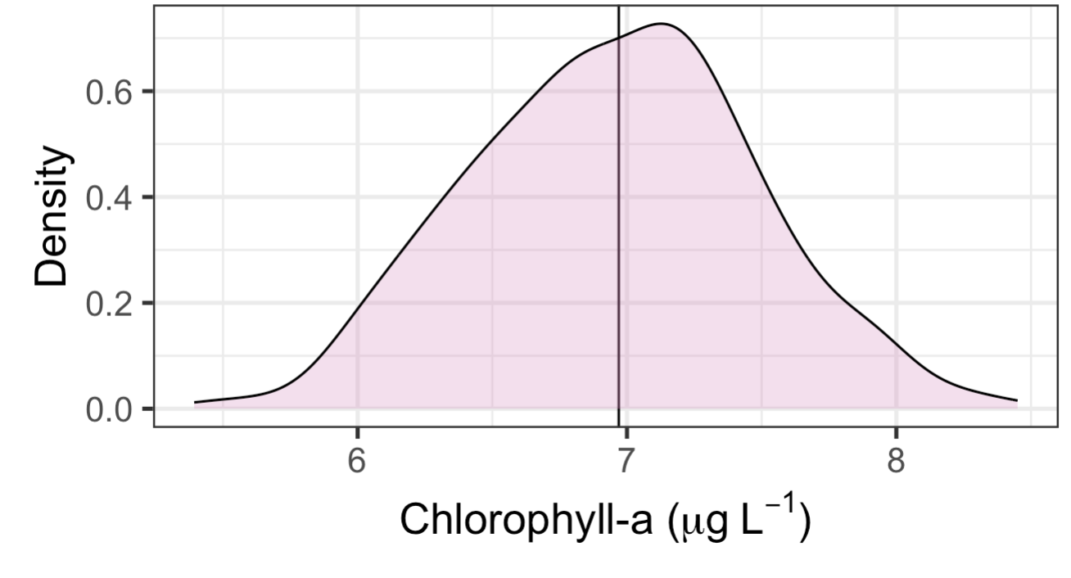
Using Distributions to Represent Uncertainty in Forecasts
Step 1: Generate a forecast with uncertainty
How do we represent uncertainty in a forecast?
Uncertainty can be represented as a distribution of all possible values of a variable
Here, uncertainty is represented as a normal distribution around the mean (observed value) of 6.95 ug/L.
observation
Notes:
We can represent uncertainty using distributions, which describe all the possible values a variable of interest might have and how likely those values are. Here is an example of a distribution that represents the uncertainty around an observation of chlorophyll-a in a lake.

Slide 15
Using Distributions to Represent Uncertainty in Forecasts
Step 1: Generate a forecast with uncertainty
Forecasts are generated using the most recent observational data to inform the initial condition (starting condition) for the forecast
initial condition
observation
Notes:
In forecasting, we use the most recent observational data to inform the initial condition, or starting condition, of the forecast. When we account for uncertainty in our observations, the initial condition will be a distribution.

Slide 16
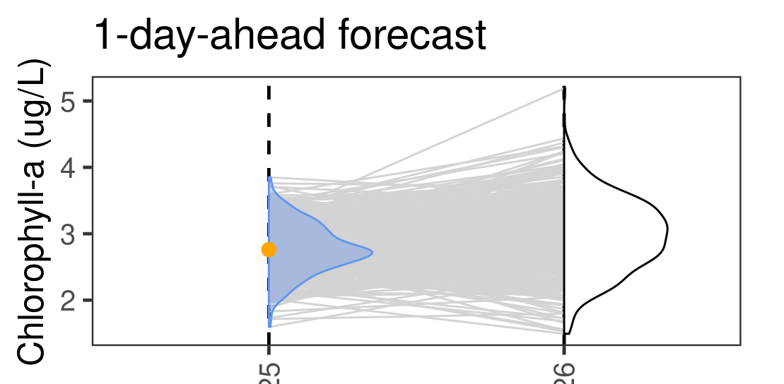
Generate a forecast
Step 1: Generate a forecast with uncertainty
Then, instead of running just a single forecast, we take many draws from our distribution and run a model many times using slightly different conditions.
The complete set of forecasts is referred to as the ensemble.
Individual forecasts within it are ensemble members.
Commonly, each member of the ensemble is equally likely to occur.
This allows us to generate a forecast with uncertainty!
today
tomorrow
initial condition
observation
ensemble
members
forecast
Notes:
Then, instead of running just a single forecast, we take many draws from our initial conditions distribution (blue distribution) and run a model many times using slightly different conditions.
The complete set of forecasts is referred to as the ensemble
Individual forecasts within the ensemble are ensemble members (gray lines)
Usually, each member of the ensemble is equally likely to occur
This allows us to generate a forecast with uncertainty (white distribution)

Slide 17
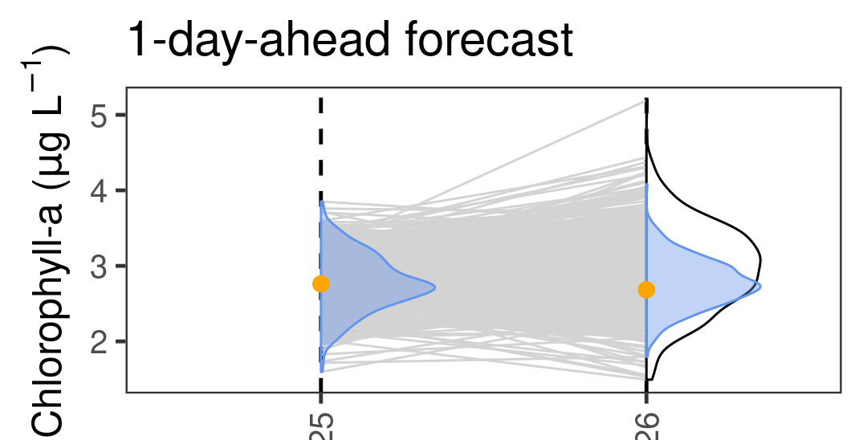
Updating initial conditions
Step 2: Update the forecast using data
New data are used to update the initial condition
This updating can be done using a technique called an ensemble Kalman filter, which accounts for uncertainty in both model predictions and new observations
yesterday
today
initial condition
observation
ensemble
members
forecast
Notes:
Once we have generated a forecast, we wait for the future to arrive and then update our initial condition using new data as they become available
This updating can be done using a technique called an ensemble Kalman filter, which accounts for uncertainty in both model predictions and new observations
You will learn about the ensemble Kalman filter in more detail in Activity B

Slide 18
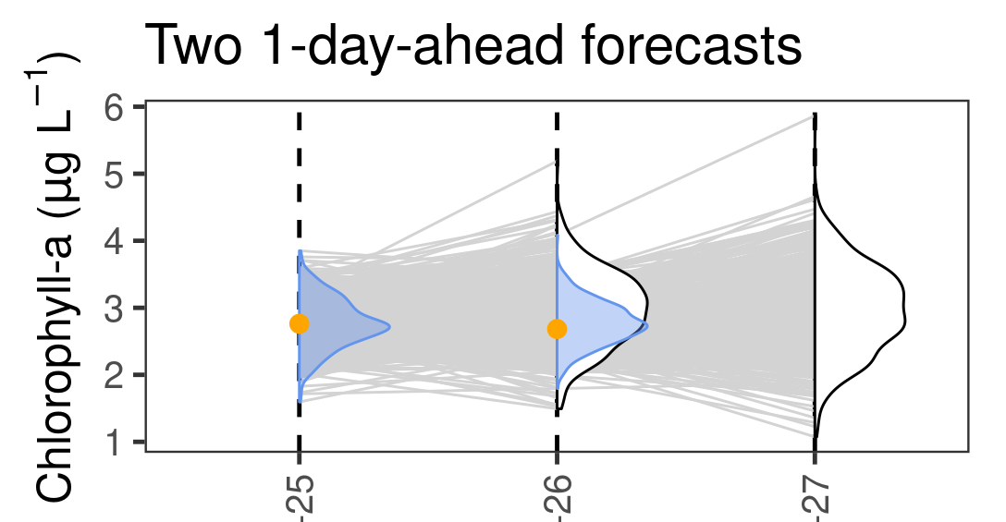
Generate a new forecast
Step 3: Generate a new forecast
A new forecast is generated using the updated initial condition
yesterday
today
tomorrow
observation
initial condition
ensemble members
forecast
Notes:
1. Finally, the new initial condition is used to generate a new forecast, once again accounting for uncertainty

Slide 19
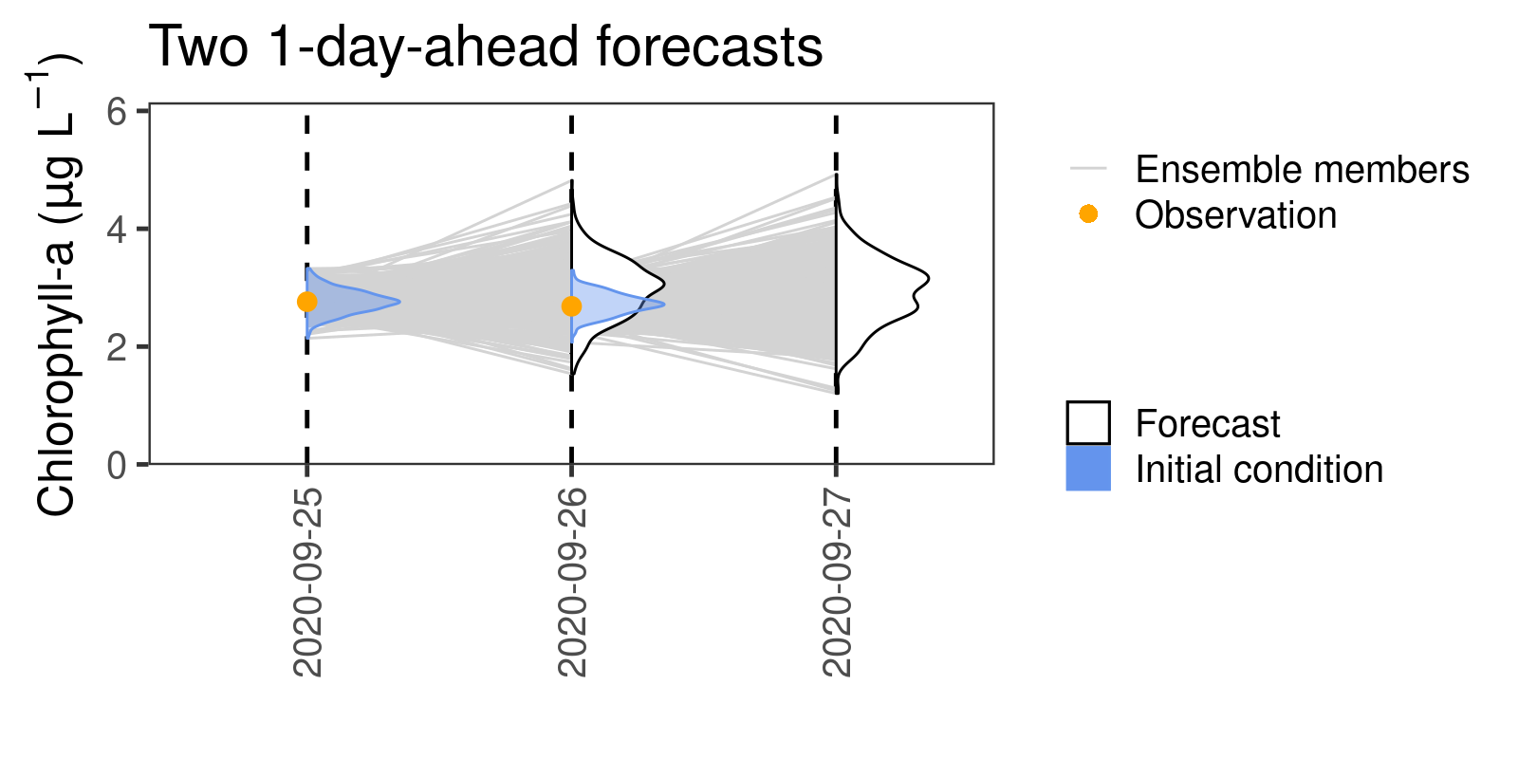
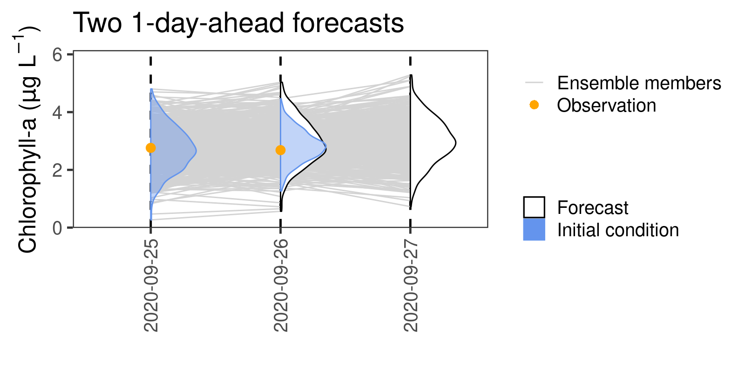
Uncertainty in models and observations
The amount of uncertainty in model predictions and observations affects how much we adjust our forecasts based on observations
Low observation uncertainty;
Forecast adjusted a lot by
point outside prediction interval
High observation uncertainty;
Forecast adjusted a little by
point outside prediction interval
yesterday
today
tomorrow
yesterday
today
tomorrow
observation
initial condition
ensemble members
forecast
Notes:
The effect of data assimilation on our models and forecasts depends on our relative confidence in our observations and our model predictions
If we observe a data point outside our predictive interval and we have low observation uncertainty, our model initial conditions and forecast will be adjusted quite a lot
If we observe a data point outside our predictive interval and we have high observation uncertainty, our model initial conditions and forecast will not be adjusted as much, because we have a relatively greater degree of confidence in our model compared to observations

Slide 20
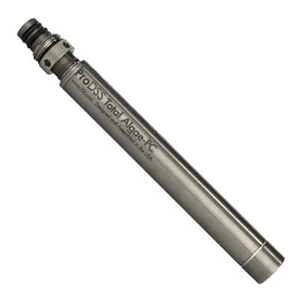

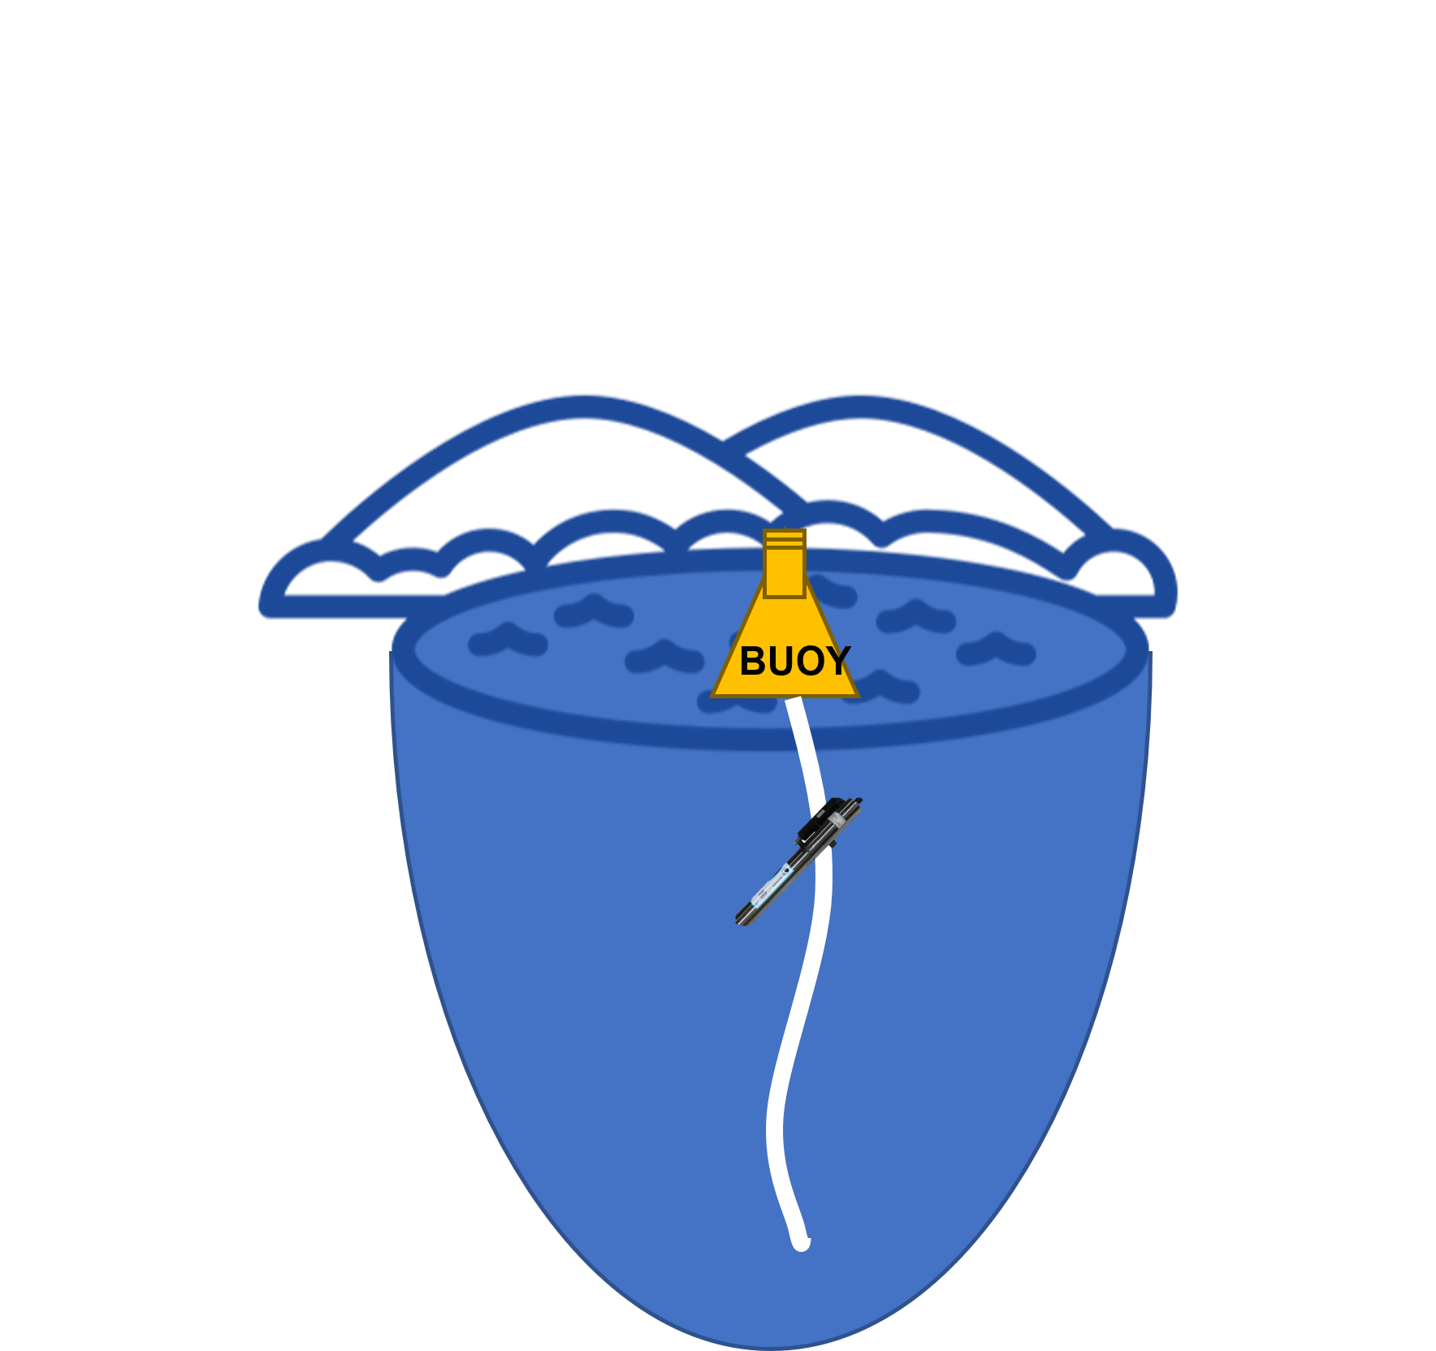


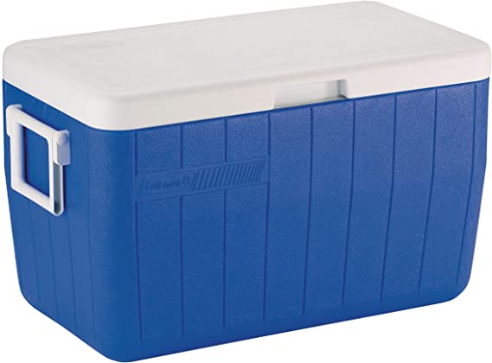
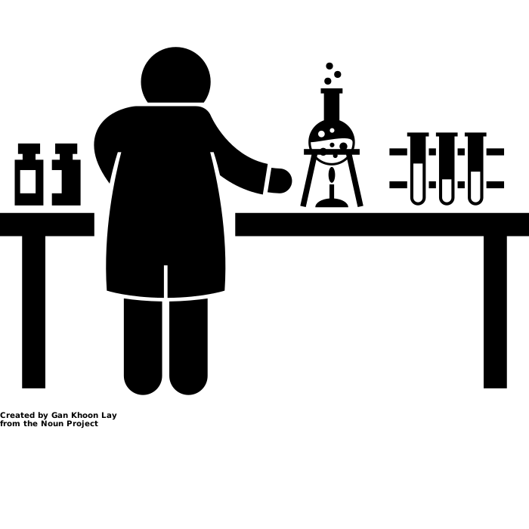
Data assimilation frequency
Field equipment | Data frequency and latency
We can only update our models with data when data are available
Data availability can also be affected both by data frequency and data latency
Data frequency: how often data are collected (i.e., temporal frequency)
Data latency: the time between when an observation is collected and when it is ready to be used in a forecast model
High frequency
Sensor
Low latency
Low frequency
Sample bottle and cooler
High latency
Notes:
We can only update our models with data when data are available
Data availability can also be affected both by data frequency and data latency
Data frequency: how often data are collected (i.e., temporal frequency)
Data latency: the time between when an observation is collected and when it is ready to be used in a forecast model
Data frequency and latency depend on the method of data collection
For example, an in-situ sensor deployed on a buoy in a lake might have high data collection frequency (e.g., every 10 minutes) and low latency (if the data are wirelessly streaming to a computer)
In contrast, manual water samples are likely collected at a lower frequency because it requires someone traveling to the site to collect a sample, and higher latency because the samples must be analyzed in the lab and the data digitized before it can be used in a forecast model

Slide 21
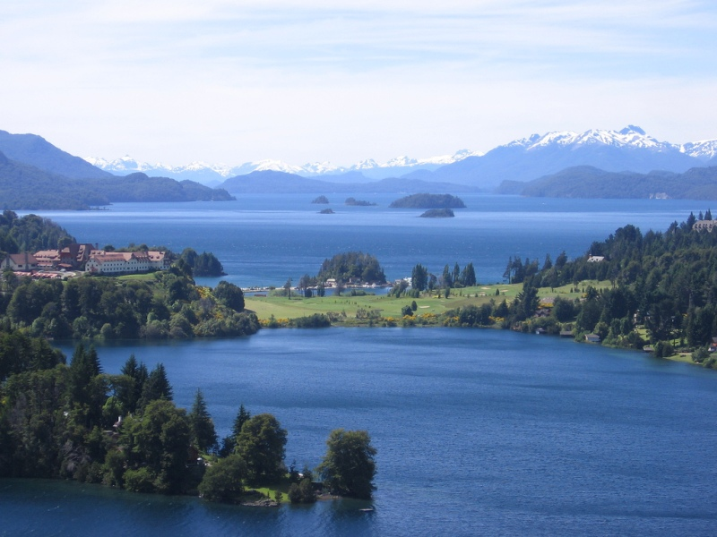
Today…
We are going to generate forecasts of phytoplankton biomass in lakes using an ecological model, and then use real data from the National Ecological Observatory Network to update the model through data assimilation.
Phytoplankton are microscopic primary producers that live in the water. They are the dominant primary producers in many lakes and reservoirs.
What are the drivers of phytoplankton biomass in a lake?
Light
Water temperature
Available nutrients
Zooplankton
Image: Wikimedia commons
Notes:
Today, we are going to generate forecasts of phytoplankton biomass in lakes using an ecological model, and then use real data from the National Ecological Observatory Network to update the model through data assimilation.
Phytoplankton are microscopic primary producers that live in the water. They are the dominant primary producers in many lakes and reservoirs.
Ask the class: What are the drivers of phytoplankton biomass in a lake? Click to reveal the list of possible drivers; note this is not a comprehensive list and there may be others that the class correctly identifies!

Slide 22
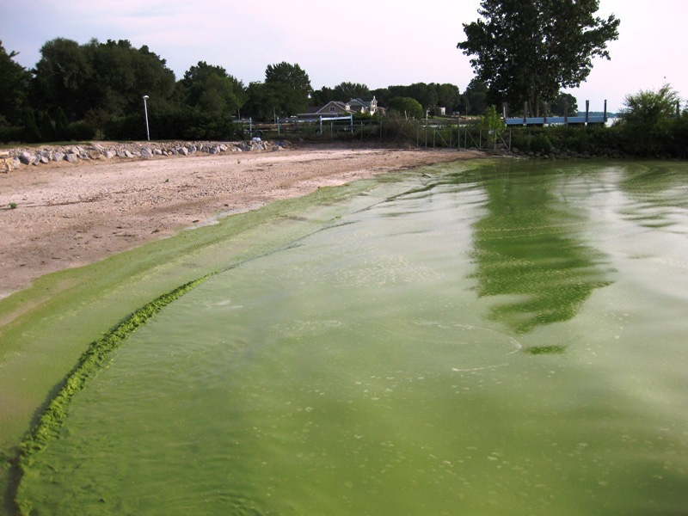
Today…
We are going to generate forecasts of phytoplankton biomass in lakes using an ecological model, and then use real data from the National Ecological Observatory Network to update the model through data assimilation.
Why forecast phytoplankton biomass in lakes?
Excess phytoplankton biomass can lead to harmful blooms, which compromise water quality through:
Production of toxins,
Production of taste and odor compounds,
Creation of anoxic zones, leading to fish kills
Image: Wikimedia commons
Notes:
Why forecast phytoplankton biomass in lakes?
Excess phytoplankton biomass can lead to harmful algal blooms, which compromise water quality through:
Production of toxins,
Production of taste and odor compounds,
Creation of anoxic zones, leading to fish kills
Pre-emptive notice of a possible harmful algal bloom via an ecological forecast could allow managers to prevent or mitigate these adverse water quality impacts.

Slide 23
Today…
We are going to generate forecasts of phytoplankton biomass in lakes using an ecological model, and then use real data from the National Ecological Observatory Network to update the model through data assimilation.
Chlorophyll-a data are a useful proxy for phytoplankton biomass in lakes.
Chlorophyll-a is a molecule that phytoplankton use for photosynthesis.
Measuring chlorophyll-a concentrations in water can give a bulk estimate of phytoplankton concentrations.
Chlorophyll-a data can be collected at a high frequency by automated sensors.
Image: Wikimedia commons
Notes:
Chlorophyll-a data are a useful proxy for phytoplankton biomass in lakes.
Chlorophyll-a is a molecule that phytoplankton use for photosynthesis.
Measuring chlorophyll-a concentrations in water can give a bulk estimate of phytoplankton concentrations.
Chlorophyll-a data can be collected at a high frequency by automated sensors; this means that chlorophyll-a data can be high frequency and low latency, which is often helpful for generating iterative, up-to-date forecasts

Slide 24
Today…
We are going to generate forecasts of phytoplankton biomass in lakes using an ecological model, and then use real data from the National Ecological Observatory Network to update the model through data assimilation.
We will fit an autoregressive model to chlorophyll-a data from a lake site of your choice.
Historical data
Forecast
An autoregressive model uses past values of a variable to predict future values.
Past
Future
Notes:
The type of ecological model we will use today is an autoregressive model
We will fit an autoregressive model to chlorophyll-a data from a lake site of your choice.
An autoregressive model uses past values of a variable to predict future values.
Students may ask: “If an autoregressive model uses past data to predict future variables, how does that differ from a forecast? Is that just a fancy name for a forecast?” If so, note that not all forecast models have to be autoregressive (though many of them are). For example, you could use a linear regression model that uses air temperature to predict water temperature for forecasting. In that case, the forecasting model is not autoregressive.

Slide 25
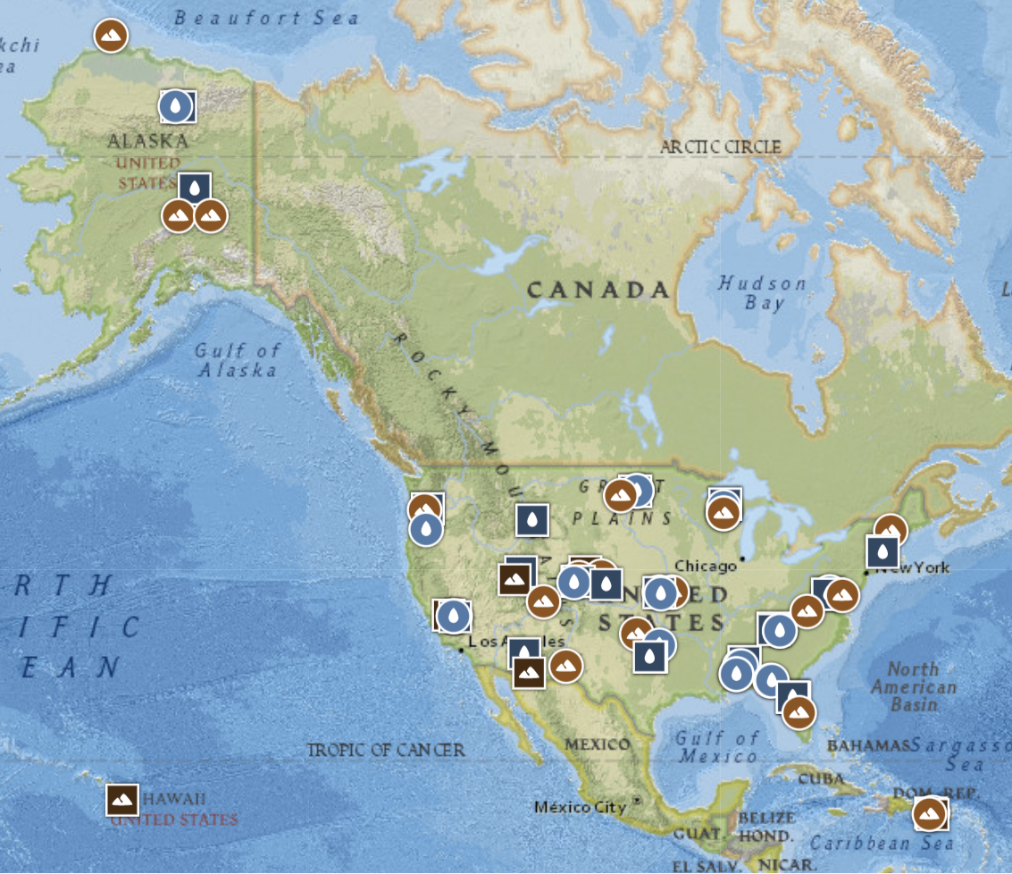
Today…
We are going to generate forecasts of phytoplankton biomass in lakes using an ecological model, and then use real data from the National Ecological Observatory Network (NEON) to update the model through data assimilation.
NEON is a continental-scale observatory designed to collect long-term open access ecological data to better understand how U.S. terrestrial and aquatic ecosystems are changing
Image: Map of NEON sites, neonscience.org
Notes:
To calibrate our model, we will use data from the U.S. National Science Foundation’s National Ecological Observatory Network, or NEON.
NEON is a continental-scale observatory designed to collect long-term open access ecological data to better understand how U.S. terrestrial and aquatic ecosystems are changing. We will be using data from five different lake sites within NEON.

Slide 26
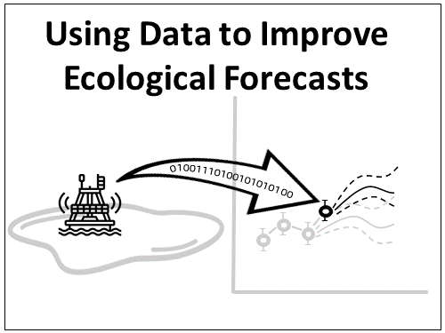
Learning objectives of today’s module:
Define data assimilation
Generate an ecological forecast for chlorophyll-a in a lake
Describe how to assess ecological forecast accuracy
Describe how data assimilation affects forecast accuracy and uncertainty
Explain how updating models with data collected at different time scales (e.g., daily, weekly) and with different levels of associated uncertainty affects ecological forecasts
Notes:
Learning objectives!
Talk through these with the students one by one: use the embedded animations to sequentially show each of the five bullet points.

Slide 27
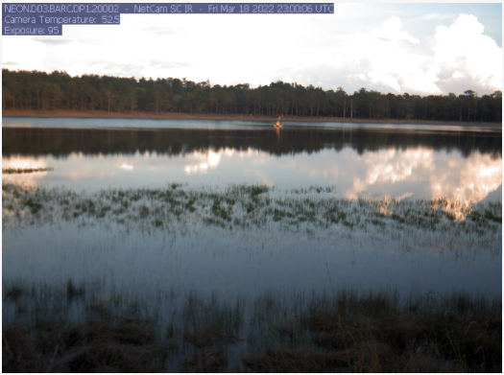
Activity A: Select a site, fit a model, and forecast
With a partner (work in pairs):
Objective 1: Select and learn about a NEON lake site
Objective 2: Explore chlorophyll-a data collected at your lake site
Objective 3: Fit an autoregressive forecast model to chlorophyll-a data
Objective 4: Generate a one-day-ahead forecast of chlorophyll-a with uncertainty
Notes:
Introduce Activity A, which has four objectives (have students work in pairs).
Objective 1: Select and learn about a NEON lake site
Objective 2: Explore chlorophyll-a data collected at your lake site
Objective 3: Fit an autoregressive forecast model to chlorophyll-a data
Objective 4: Generate a one-day-ahead forecast of chlorophyll-a with uncertainty

Slide 28
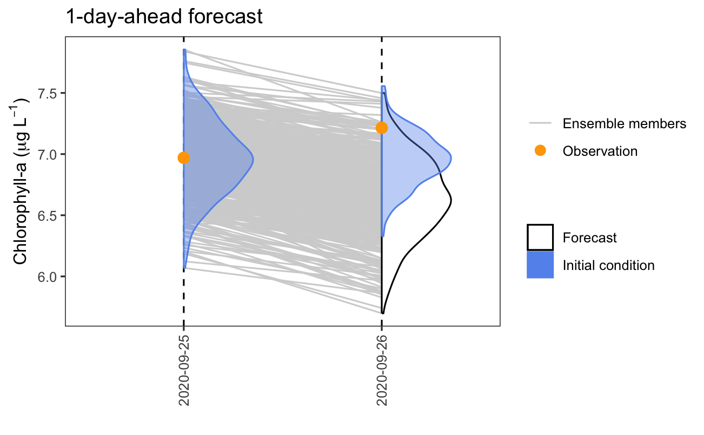
Activity B: Examine how data assimilation affects forecasts
With a partner (work in pairs):
Objective 5: Compare one-day-ahead forecasts generated with and without data assimilation.
Objective 6: Compare forecasts updated using data with low vs. high observation uncertainty.
Objective 7: Compare a series of forecasts updated with data at different frequencies (e.g., weekly, daily).
Notes:
Activity B – continue working in pairs and answer the questions individually. Generate multiple forecasts while assimilating data at different temporal frequencies and with different amounts of observation uncertainty.
Objective 5. Compare one-day-ahead forecasts generated with and without data assimilation.
Objective 6. Compare one-day-ahead forecasts generated with data assimilation, using data with low vs. high observation uncertainty.
Objective 7. Compare a series of one-day-ahead forecasts with no data assimilation, weekly data assimilation, and daily data assimilation.
At the end of Activity B, regroup as a class and each of the groups present the results from their forecast and how their forecast got better or worse with different methods of data assimilation

Slide 29
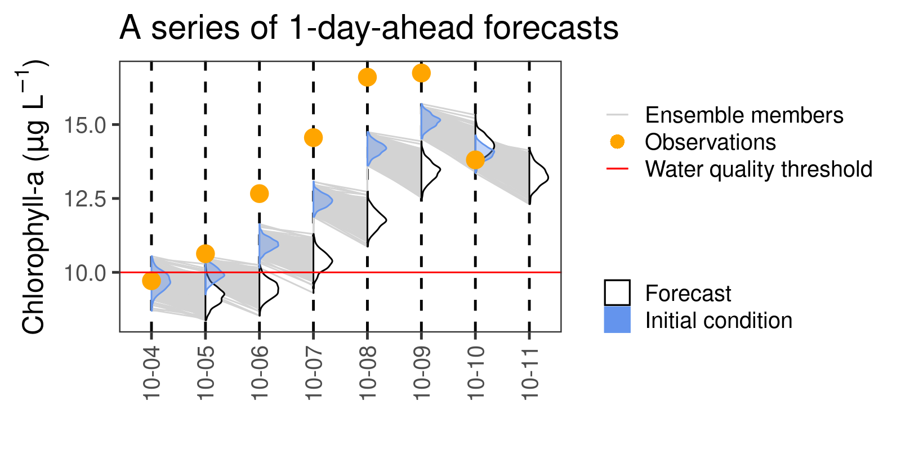
Activity C: Make a management decision using forecasts with data assimilation
With a partner (work in pairs):
Objective 8: Make management decisions using forecasts generated with different frequencies of data assimilation.
You may have the opportunity to present your choice and the resulting forecasts to the class.
Notes:
Activity C – continue working in pairs and answer the questions individually.
Objective 8. Make management decisions using forecasts generated with different frequencies of data assimilation.
You may have the opportunity to present your choice and the resulting forecasts to the class.

Slide 30

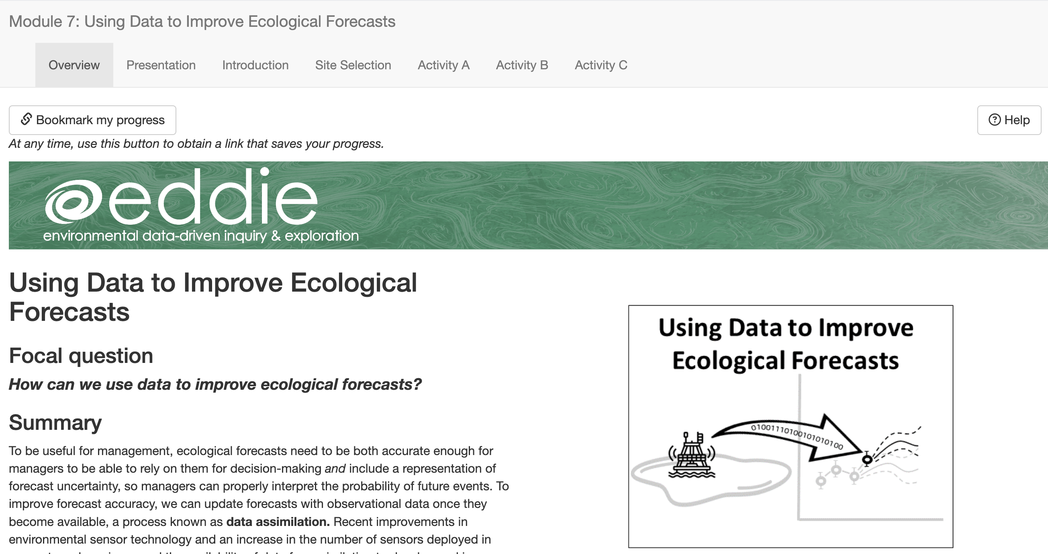
Shiny App
The module can be accessed at: https://macrosystemseddie.shinyapps.io/module7/
This is an interactive webpage built using R
It has interactive plots and options embedded which allow you to build your own personal model, visualize and explore the data, and answer questions
Notes:
Shiny App:
The module can be accessed at: https://macrosystemseddie.shinyapps.io/module7/
This is an interactive webpage built using R code
It has interactive plots and options embedded which allow you to build your own personal model, visualize and explore the data, and answer questions

Slide 31

Downloading the Report
Navigate to the “Introduction” tab
Click on the “Download Final Report Template” button to download a Word document into which you can type your answers.
Notes:
Generating the student report. At this point, the instructor may choose to navigate to the Shiny app and demonstrate its features while screen sharing the app in a browser. Alternatively, the instructor may cover the material on slides 30-32 in PowerPoint.

Slide 32
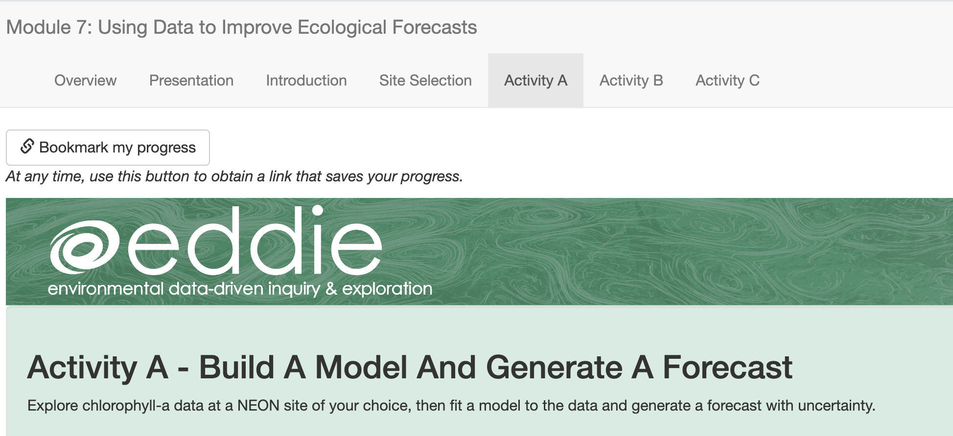
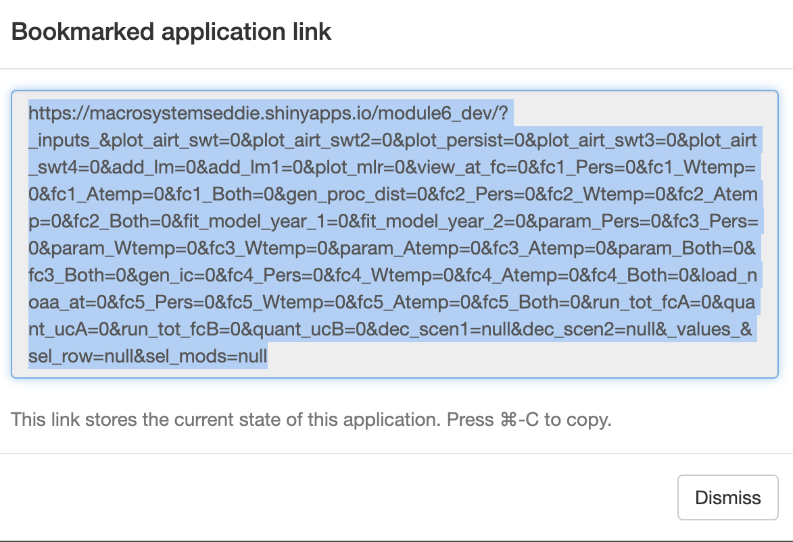
Saving & Resuming Progress
Saving Progress
Scroll to top of the page.
Click on the “Bookmark my progress” button. A pop-up window with a very long link will appear.
Copy-paste the link and store it at the top of your final report.
Resuming progress
Open your browser.
Copy-paste the link into your browser.
As you navigate through the tabs in the module, your progress will reappear.
Notes:
Saving & resuming progress in the Shiny app.

Slide 33
We recommend that you save your progress often!
Because the Shiny app can time out after inactivity (15 minutes) or disconnect if an internet connection is interrupted, we don’t want you to lose your work.
Save your progress as you go, as well as every time you close your computer or close the Shiny app in your internet browser.
After you save the link somewhere safe, you should be able to resume your progress where you left off!
Notes:
We recommend that you save your progress often!

Slide 34
Let’s Go!
For the activity we will work in pairs.
Each pair selects the same NEON site and works through Activities A, B, and C.
It is possible that more than one pair will be assigned to the same lake.
Lake name | Students
Crampton Lake
Suggs Lake
Barco Lake
Prairie Pothole
Little Rock Lake
Prairie Lake @ Dakota Coteau
https://macrosystemseddie.shinyapps.io/module7/
Notes:
Help students transition over to the Shiny app and get started. Instructors may use the table to record which students are working with which lake sites, if helpful.

Slide 35
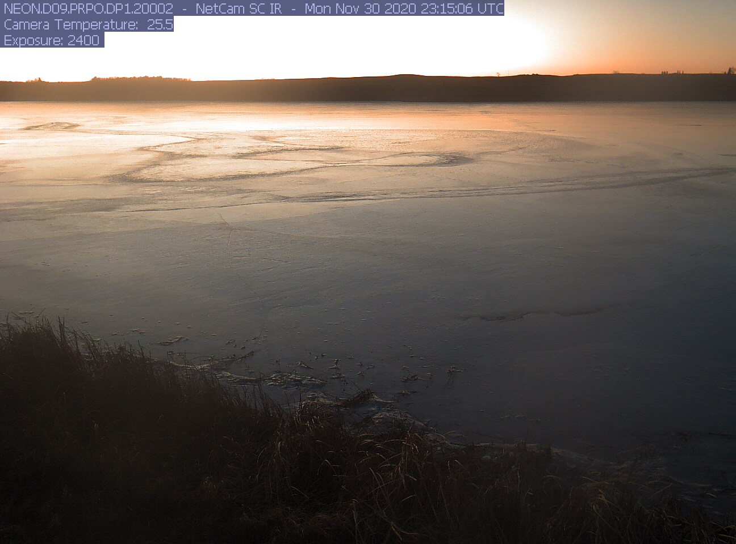

Thank you for participating!
Check out other ecological forecasting modules:
Module 5: Introduction to Ecological Forecasting
Module 6: Understanding Uncertainty in Ecological Forecasts
Module 8: Using Ecological Forecasts to Guide Decision-Making
Find out more at: macrosystemsEDDIE.org
Notes:
Thank you for participating!

